Slide 1

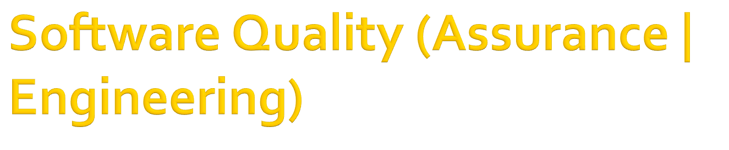
In the name of Allah, the Beneficent, the Merciful
CSC312 / CSE312
by Dr. M. Bilal Bashir
Lecture 7: Static Testing

Slide 2

Prevention is better than cure
Finding out defects at early development stages is better to realize the defects at later development stages
Work products are manually reviewed
  Source code without execution

Slide 3

Defect reduction in software by reducing defects in the documentation from which the software is developed
Correct operation of the software

Slide 4

What you do when you make a program?
  Think about the logic
  Start writing the code
  Compile the code immediately
  Check for the syntax errors
  Make corrections
  Execute the code
    Provide some test inputs
    Check the outputs whether expected or not

Slide 5
Managers and programmers found static testing before dynamic testing uncover errors easily
Can be applied to any work product
Two ways to carry out:
  Structured Group Examination: Manual review of work products (SRS Document, design document, source code, test plans, test cases etc.)
  Using static analysis tools

Slide 6

Specification document -> User Specified behavior
Source code->Specified requirements
Design document->SRS Document
Design is really implemented ?
Code is written as per standards?
Easy to find interface specifications
Better in code optimization

Slide 7

Incorrect and missing specification can be found at an early stage of development
Incorrect design can be found early and reduce life cycle time
Specifications can be checked against the code
Coding guidelines can be checked to make the software maintenance easy

Slide 8

As a result time effort and money required for the total development life cycle will be reduced
Dynamic testing reveals failures but Static testing reveals defects
Static testing prior to dynamic testing is highly recommended

Slide 9

Examination which is conducted manually
Individual or a group examines a document with the objective of defect detection
SGE also referred as: Reviews
Can be conducted on any developed document

Slide 10

There are multiple types of reviews listed as follows:
  Informal reviews
  Walkthroughs
  Inspection
  Technical review

Slide 11

Unstructured process of work product review
Review is conducted by an individual
Review comments or defects are not recorded in any document
Defects are communicated to the author/developer by reviewer
Author fixes the defects by document modifications
Reviewer are assigned by the project owner with respect to the expertise level

Slide 12

Typically, reviewer are either technical or functional experts
It is a quick and inexpensive review process

Slide 13

Pros of the informal reviews:
  This is the least expensive review process
  Time taken for this review is minimum
Cons of the informal reviews:
  Might not be able to detect all the defects
  No formal documentation:
    Incorrect defect identification and not finding root cause
  Process of an Individual dependence can affect the effectiveness

Slide 14

Walkthrough is also an informal review method but a group activity
Author presents the work in a group meeting
Group generally formed by the project owner or QA team
Author presents the work and discusses various scenarios
Participants can comment , present their views and ask questions

Slide 15

The decision to accept a defect is dependent to the author
The resolutions are also discussed and adopted
Walkthroughs are more formal than informal reviews but less formal than the Inspection

Slide 16
Pros of walkthrough:
  Multi-people involvement, different perspectives presented results as improved product
  Learning of group members is greatly enhanced
  Suitable for small team 5(-10 people)
Cons of walkthrough:
  Not suitable for critical document
  Process is author dependent and can resist the suggested improvements

Slide 17

Most formal process and conducted in the structured way
Process is carried out when module/project owner decides that work product is ready as it is a costly process

Slide 18

The key characteristics of inspection are:
  Conducted by moderator
  Conducted by peer of the authors not the author
  Roles are defined for the review
  Entry and exit criteria for the review process are defined
  All participants are well informed about meeting
  Formal follow-up processes are followed
  Findings are tracked to closure

Slide 19
Pros of inspection review:
  Structured process, so defects detection chances are high
  Defects are analyzed and root cause analysis is conducted
  Working on root cause also eliminates the chances of similar defects in the future
  The follow-ups are done formally and hence all the defects are tracked

Slide 20

Cons of Inspection review:
  Amount of effort is high
  Due to high cost, used only for critical work products

Slide 21

Primary objective is to check compliance of work product with the specification, suitability of its intended purpose & defined standards
Checklist and guidelines are prepared in advance and handed over to the reviewer
Reviewer records the comments
A review meeting is organized, which is scheduled by a moderator
Reviewer comments are sent to the moderator before meeting

Slide 22

Meeting is attended by a moderator , a recorder and review team members
Author does not participate
Recordings of discussion and minutes is the responsibility of the recorder
Review comments might be accepted or dropped
Once the findings are accepted, they are forwarded to the project team

Slide 23

Review types are not mutually exclusive
Some factors can be considered while choosing:
  Informal methods: When time and effort is key to consider
  Formal inspection: if the owner is assured of not loosing much time or cost is affordable than it can be used
  Technical reviews: if technical skills are available

Slide 24

Review process document contains the following sections:
  Entry criteria
  Planning
  Preparation
  Review Meeting
  Rework
  Follow-up
  Exit Criteria

Slide 25

Defines the conditions which must be completed before the review process can start
  Work product has been completed
  Work product depending on others must be completed
  Reviewer has been selected
  If it is a re-review, all previous comments have been accommodated

Slide 26

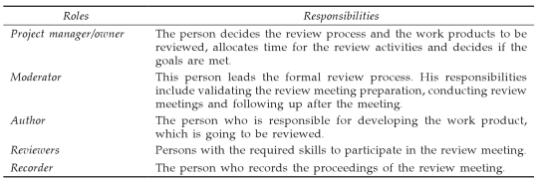
It includes:
  Intended goals of the review process
  Review type to be used
  Review team
  Roles and responsibilities

Slide 27

Team members are expected to prepare for the meeting
They get sufficient time to access even external material and get the complete perspective
Moderator informs every one in advance about the schedule

Slide 28

Moderator send reminder to all on the meeting day
Moderator introduces participants and objectives
Moderator presents the work
Team raises concerns, feedbacks
Accepted and valid concepts are recorded in the review log
Review log is circulated

Slide 29

Review comments or defects are sent to project team
Team analysis the effort to fix review comment
This effort is known as rework

Slide 30

Project manager or moderator follows up with the team members (who are assigned to fix the defects)

Slide 31

Intended goals are satisfied
All the defects raised during the review meeting are tracked to closure
Uncorrected defects are logged in the project defect tracking system

Slide 32

For review meetings to succeed, manager and all the team members should keep in mind:
  Find defects, not to find who did
  Discuss issue, but not argue
  No emotional attachment with work product
  Objectives should be clearly defined
  Checklist and guidelines must be used
  Manager should provide the necessary resources

Slide 33


“You have done a good job, but why don’t you make your code highly reliable by testing it with the following test cases and ensuring that the code works for these cases also”

Slide 34


“your code does not work for this particular test case, damn it. Make it work”

Slide 35

Summary

